Slide 1

Erlang, CQRS and .NET walk into a bar

Slide 2



Erlang, CQRS
and .NET
walk into a bar
presented by Bryan Hunter Firefly Logic
Twitter #erlang #cqrs
#devLink
@bryan_hunter
@fireflylogic

Slide 3
Why?

Slide 4
Why Erlang?

Slide 5
First, what in the heck is Erlang?
Erlang (the language)
+ OTP (libraries, practices, reusable bits)
+ ERTS (Erlang Runtime System)

Slide 6
OK, now why Erlang?

Slide 7
> Why Erlang?
Erlang is open, proven and cross-platform. It simplifies writing reliable, concurrent, distributed systems. Its pattern matching is FTW.

Slide 8
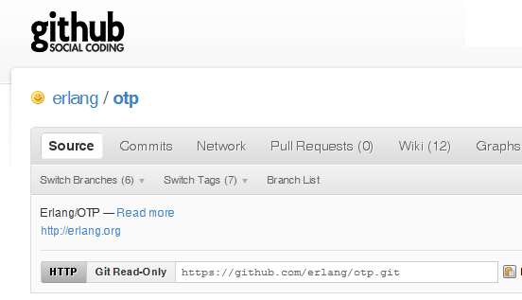
Why -> Erlang is open

Slide 9
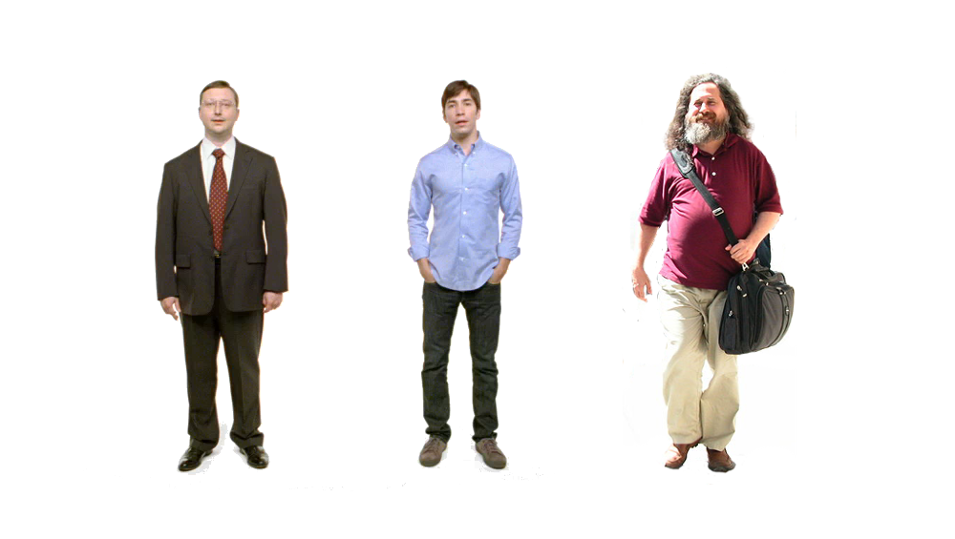
Erlang
Erlang
Erlang
Why -> Erlang is cross-platform

Slide 10







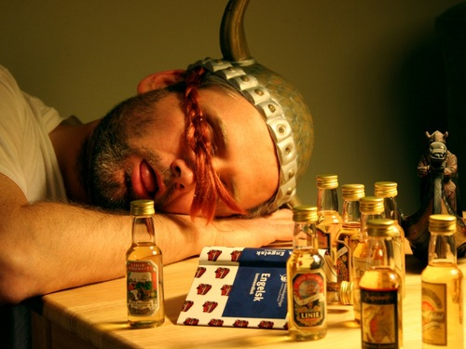






Why -> Erlang is proven

Slide 11
Two thing to remember about
Concurrency
1) Shared memory concurrency is hard
2) Message passing concurrency is easy

Slide 12
One .NET 4.0 Thread (allocates one megabyte)
**********
**********
**********
**********
**********
**********
**********
**********
**********
**********
**********
**********
**********
**********
**********
**********
**********
**********
**********
**********
**********
**********
**********
**********
**********
**********
**********
**********
**********
**********
**********
**********
**********
**********
**********
**********
**********
**********
**********
**********
**********
**********
**********
**********
**********
**********
**********
**********
**********
**********
Heap
Mailbox
Stack
**********
**********
**********
**********
**********
**********
**********
**********
**********
**********
**********
**********
**********
**********
**********
**********
**********
**********
**********
**********
**********
**********
**********
**********
**********
**********
**********
**********
**********
**********
**********
**********
**********
**********
**********
**********
**********
**********
**********
**********
**********
**********
**********
**********
**********
**********
**********
**********
**********
**********
Garbage Collector
Links and Monitors
One Erlang Process (allocates one kilobyte)
*

Slide 13
*
*
*
Reductions
- Do 2,000 operations
reduction1 reduction3 .
Reduction2000
- Move to the next guy - Repeat
CPU Core

Slide 14
***** *****
***** *****
***** *****
***** *****
Core
Core
Core
Core

Slide 15
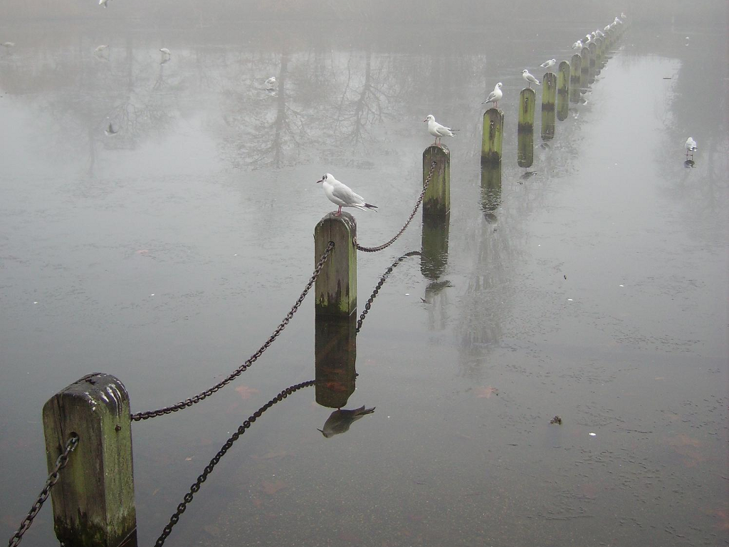

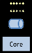
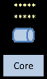
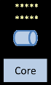
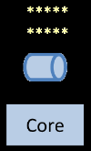
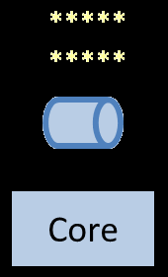
Distribution: built-in from the start

Slide 16
> Erlang reliability
Nines | Uptime | Annual Downtime
9 | 99.9999999% | 30 milliseconds
8 | 99.9999990% | 300 milliseconds
7 | 99.9999900% | 3 seconds
6 | 99.9999000% | 32 seconds
5 | 99.9990000% | 5 minutes
4 | 99.9900000% | 53 minutes
3 | 99.9000000% | 8 hours, 46 minutes
2 | 99.0000000% | 3 days, 15 hours, 36 minutes

Slide 17
> Erlang reliability
Supervisor
Supervisor
Supervisor
Worker
Supervisor
Supervisor
Worker
Worker
Worker

Slide 18
What and why CQRS?

Slide 19
CQRS is Command Query Responsibility Segregation.
> What is CQRS?

Slide 20
CQRS is an architectural pattern.
> What is CQRS?

Slide 21
CQRS
takes the programming principle of CQS (read or write – pick one) and applies it “to the big”
> CQRS extends CQS to the big

Slide 22
Command Query Separation (CQS)
“Every method should either be a command that performs an action,
or a query that returns data to the caller, but not both.”
> CQRS extends CQS to the big

Slide 23
Command Query Separation (CQS)
void MutateState(…); - or - MyResult DontChangeAnything(…);
> CQRS extends CQS to the big

Slide 24
CQRS is heresy
> What is CQRS?

Slide 25
Why CQRS?

Slide 26
> Why CQRS?
Domain Driven Design: it sounds good, but when I try doing it I feel like a big fraud.

Slide 27
> Why CQRS?
Bog standard
(not CQRS)
SQL
ORM
IRepository<T>
DTOs
Two way data binding
load()
Client
save()

Slide 28
> How CQRS
CQRS
Read store
Event store
EventHandler
EventHandler
Event
Aggregate
DTO
Command Handler
Durable queue
Command
Client
Readonly
Command Builders
Tasks

Slide 29
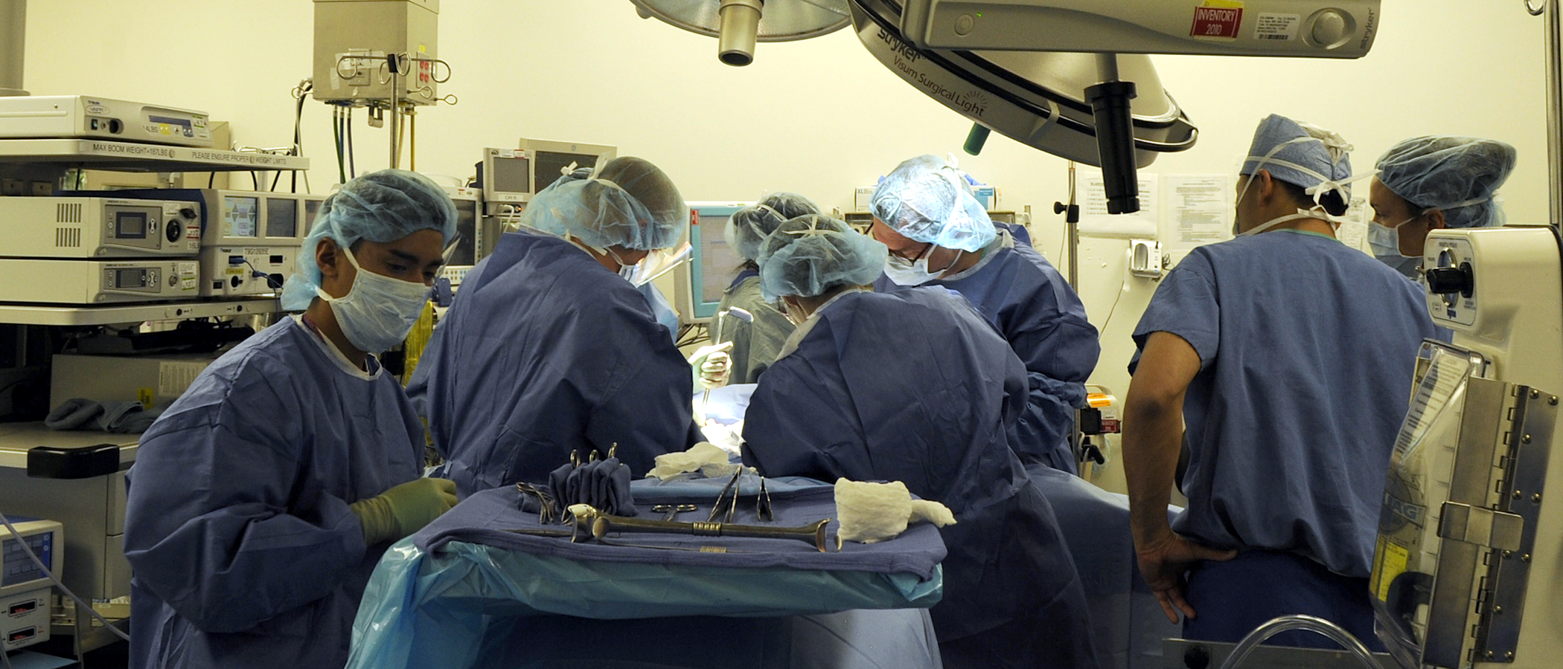
> Why CQRS?
returns focus to the business

Slide 30
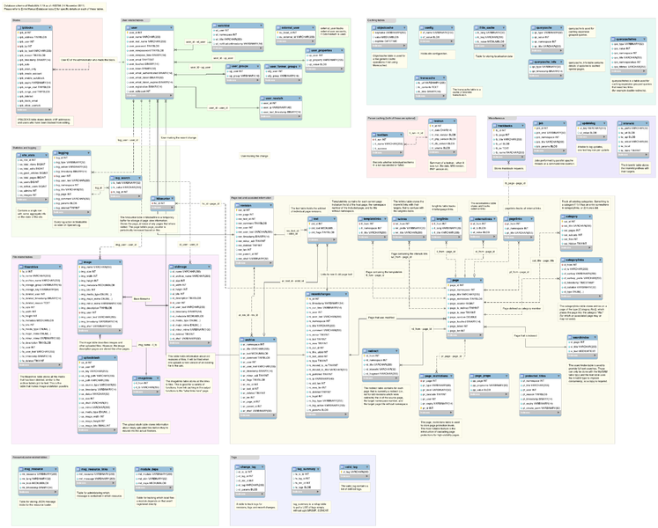
> Why CQRS?
keep your privates private

Slide 31

> Why CQRS?
vendor relationships should be consensual

Slide 32
> Why CQRS?
scaling out
$
$
$
$
$
$
$
$
$
$
$
$
$
$

Slide 33
> Why CQRS?
tunable performance
Available
Partition tolerant
Consistent

Slide 34
> Why CQRS?
simplify conflicts, read-write contention, and concurrency
9
0
1
2
3
4
5
6
7
8

Slide 35
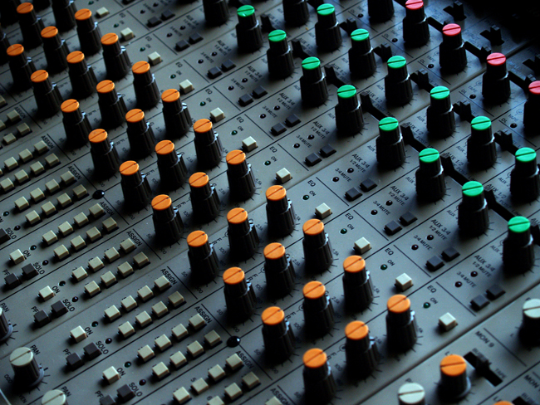
> Why CQRS?
explicit & tunable staleness

Slide 36
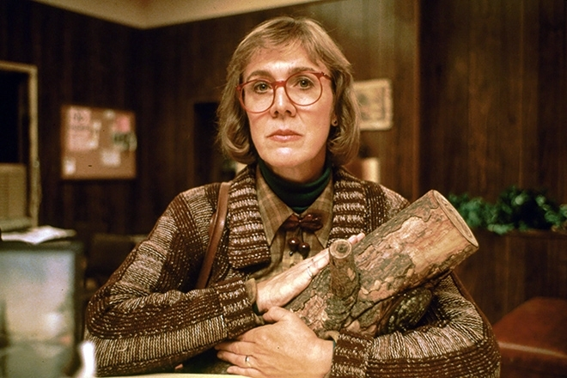
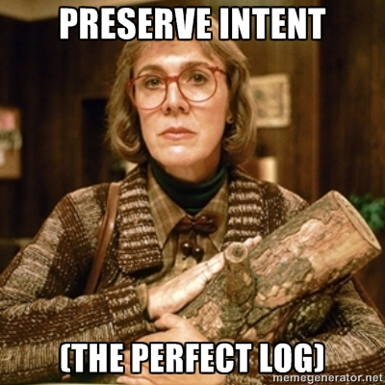
> Why CQRS?
http://memegenerator.net/Twin-Peaks-Log-Lady

Slide 37

> Why CQRS?
Big Design Upfront YAGNI Just-in-Time Maintenance

Slide 38
Why .NET?

Slide 39
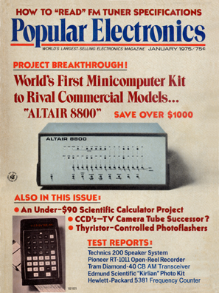

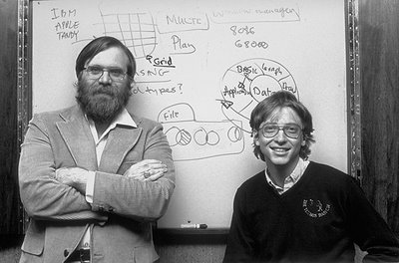
> Why .NET? Made by programming heroes!

Slide 40
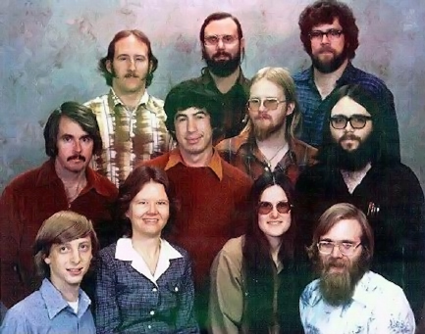
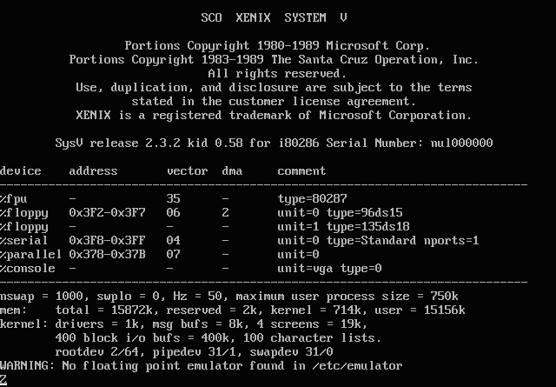
1980 licensed UNIX source code from AT&T branded it Xenix
(later sold it to SCO)
> Why .NET? Made by smart business people

Slide 41

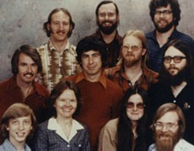
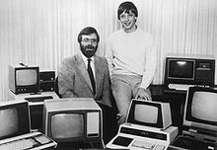
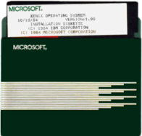
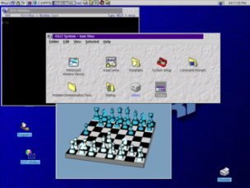



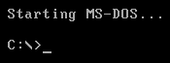
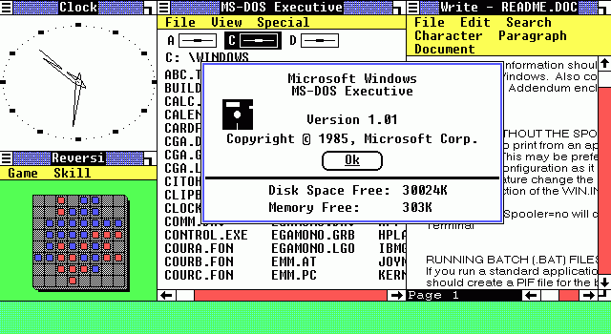
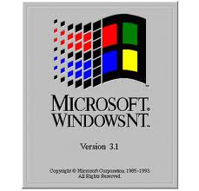




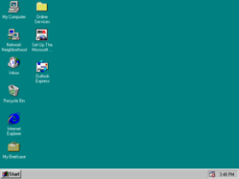




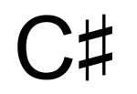
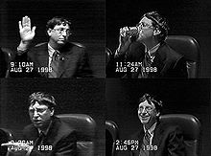
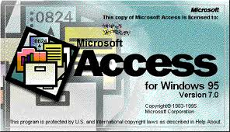

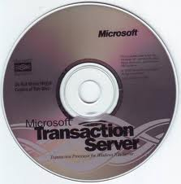



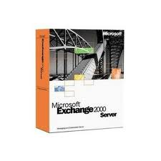
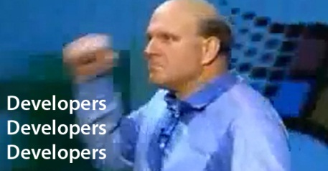
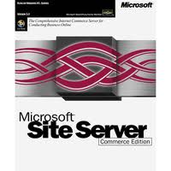








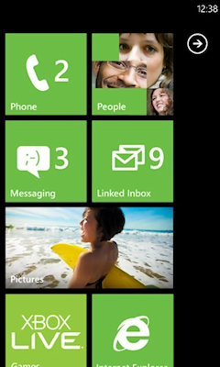


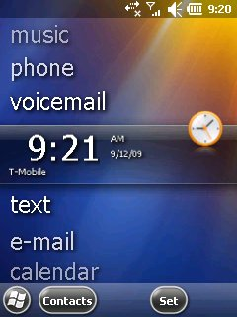








It looks like you want to do something with a computer.
Would you like help?
> Why .NET? > Microsoft has a lot of stuff

Slide 42
CQRS core concepts
Task-based UI
Separate data stores for reads and writes
Commands
Aggregates
Events
Queries
Eventual consistency
Event sourcing
Messaging

Slide 43
> Parts of CQRS?
Inductive User Interface / Task-based UI
Focus each screen on a single task.
State the task.
Make each screen suit the task.
Offer links to secondary tasks.

Slide 44
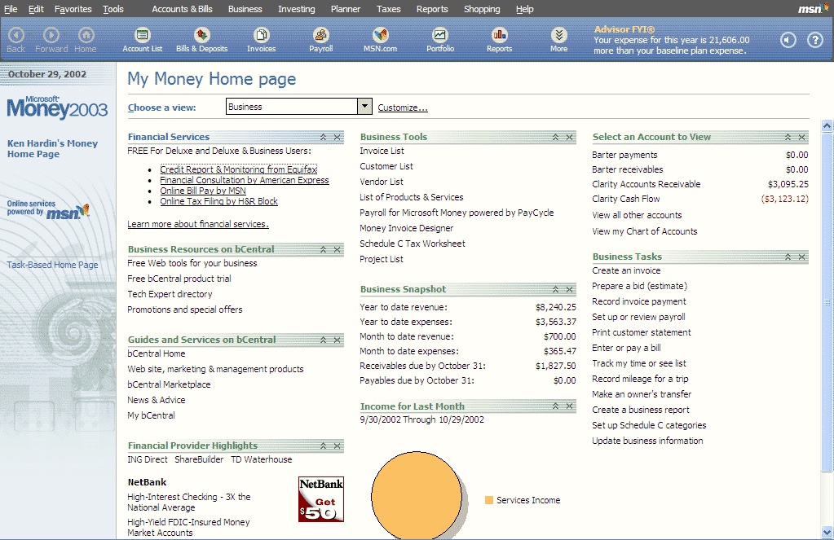
> Why .NET? > Money 2000 and “Inductive UI”

Slide 45
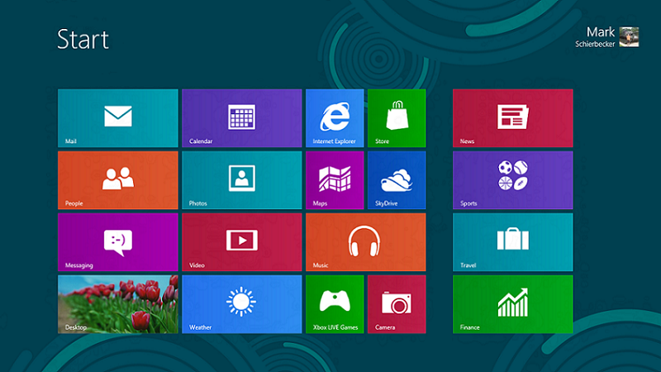
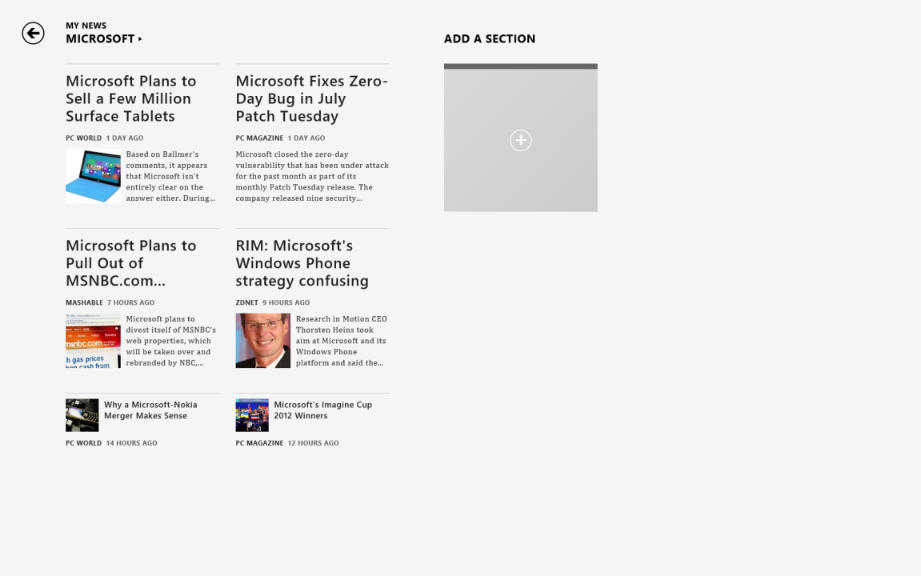
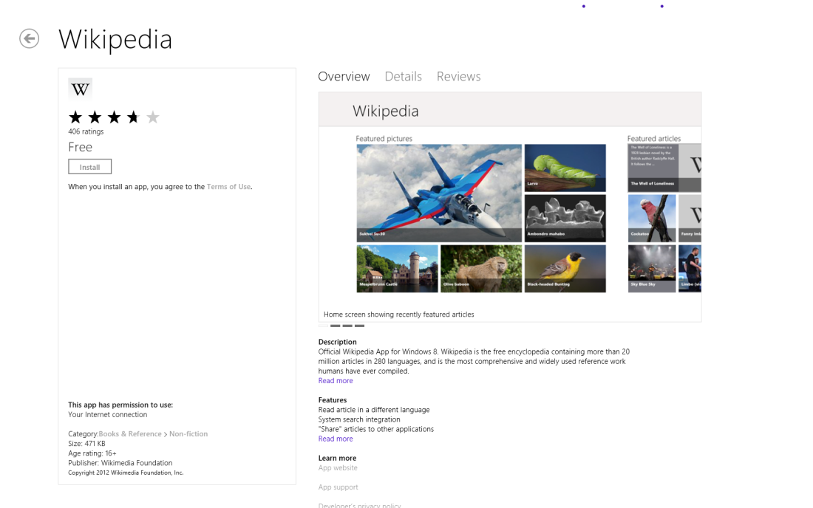
> Why .NET? Metro

Slide 46
> Why Erlang for CQRS?
“Any sufficiently complicated concurrent
program in another language contains
an ad hoc informally-specified bug-ridden
slow implementation of half of Erlang.” -Virding's First Rule of Programming

Slide 47
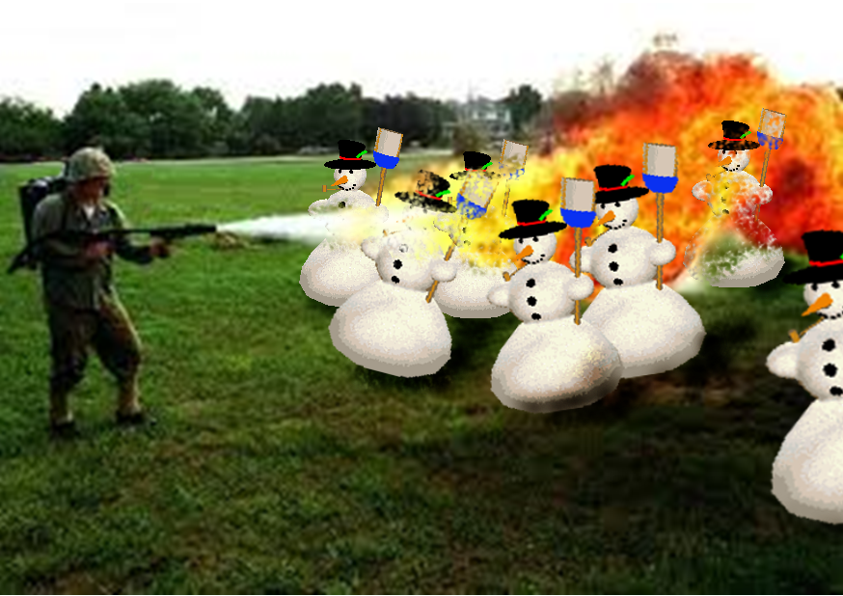
> Why Erlang for CQRS?
Right tool for the job

Slide 48
When you reach for CQRS you are solving problems that led these guys
to
…to

Slide 49
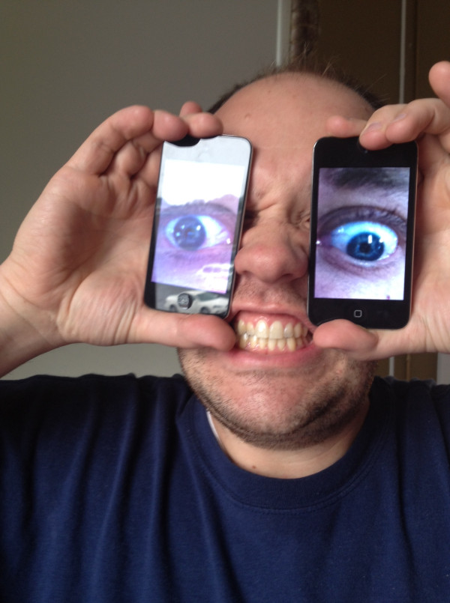

Slide 50
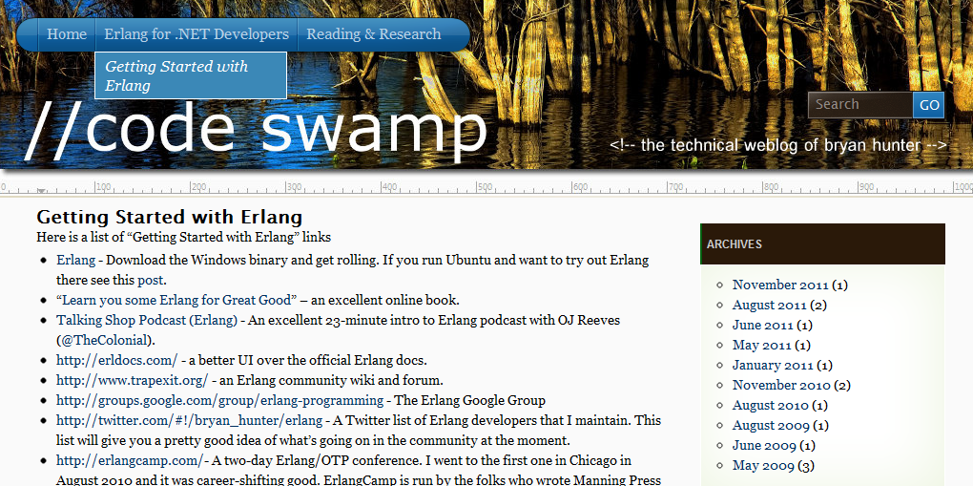
“Getting started” links, script to build Erlang from source on Ubuntu, ongoing screencasts of the Erlang tool-chain,
Info on the book-in-progress “Erlang for .NET Developers”
How -> visit my blog at http://www.codeswamp.com

Slide 51
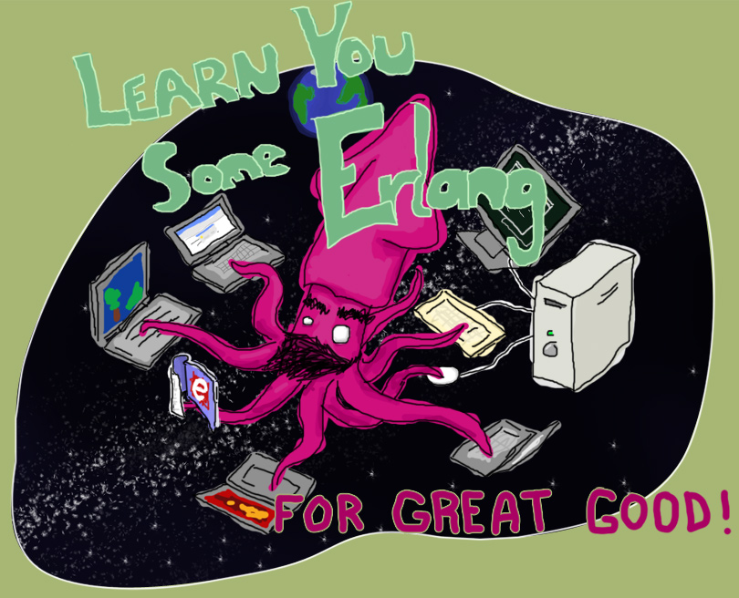
“Learn You Some Erlang for Great Good!” http://learnyousomeerlang.com/
How -> read this excellent and free online book

Slide 52



How -> read some books

Slide 53
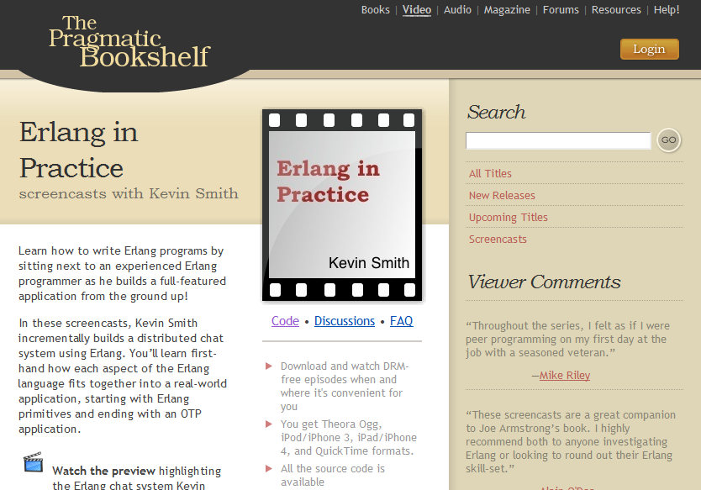
Search “pragmatic kevin smith”
How -> code alongside Kevin Smith for eight screencasts

Slide 54
NashFP Nashville Functional Programmers
http://nashfp.github.com
How -> join your local FP group

Slide 55
Bryan Hunter
Twitter: @bryan_hunter
Email: bryan.hunter@fireflylogic.com
Blog: bryanhunter.freshbrewedcode.com and old stuff at codeswamp.com
Firefly Logic, Inc.
1000 Main Street, Suite 201 Nashville, TN 37206
http://fireflylogic.com

